Slide 1
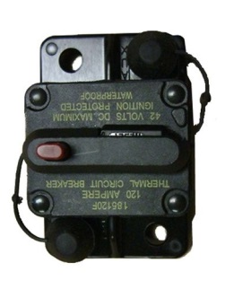
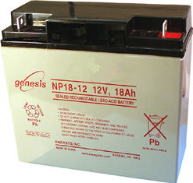
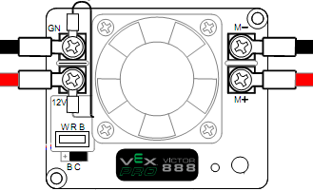
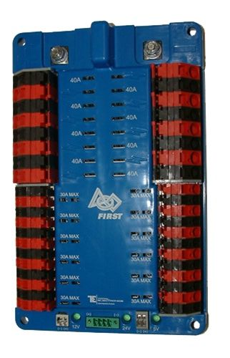
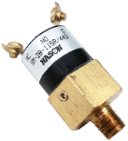
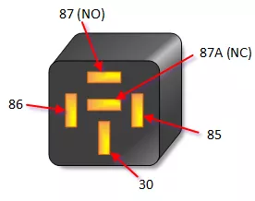
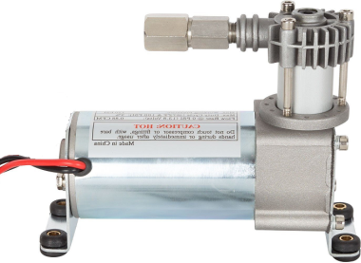
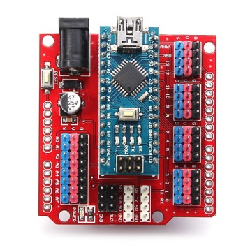

FRANKENSTEIN FRISBEE BOT WIRING
DRIVETRAIN
LEFT 2
DRIVETRAIN
RIGHT 2
DRIVETRAIN
LEFT 1
DRIVETRAIN
RIGHT 1
SHOOTER2
SHOOTER1
PWMs to here
& controllers
Shooter Controllers MUST be set to COAST

Slide 2






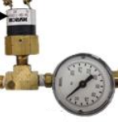
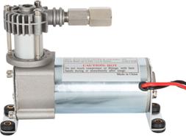

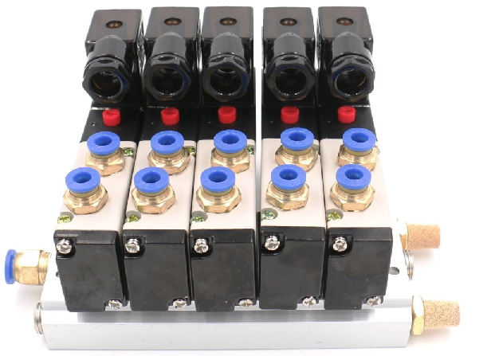
FRANKENSTEIN FRISBEE BOT PLUMBING
High pressure storage (120psi)
RAISE/LOWER
SHOOTER
FIRE
FRISBEE
Pressure regulator
With pressure gauge
Note the way this is plumbed, solenoid will extend by default. This is the fail safe state. As retracting this actuator FIRES a Frisbee.
B
A
S
High Low ← Pressure Pressure →
P
R

Slide 3
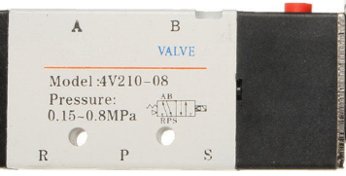

SOLENOID VALVE & MANIFOLD INFORMATION
Solenoid State | Port A | Port B
De-energized (OFF) | Pressurized | Vented
Energized (ON) | Vented | Pressurized
Valve Outputs To Actuators
B
A
Pressure inlet
into manifold
S
P
Vented Air
Outputs
R

